Slide 1
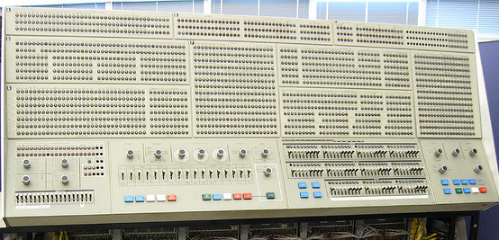
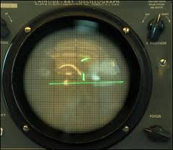
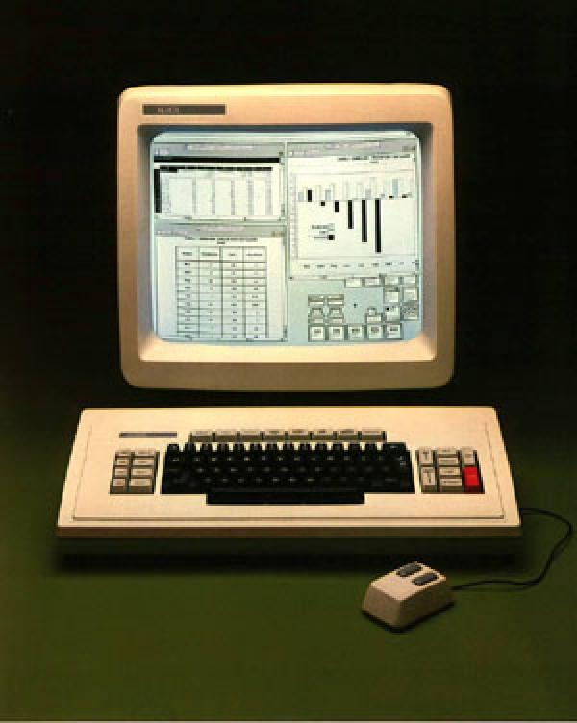
First course of Computer Science
http://living-information.de/pdf/gui_history.pdf
http://cs.iupui.edu/~cs265/spring06/slides/t03IntroToQt.ppt
Computer Graphics: Principles and Practice. Foley, van Dam, Feiner
Part VII: GUI - Friendly Interface for users

Slide 2
Goals
Know the advanced services provided by most OSs – GUI
The related IO devices
Mechanism
Architecture of UIMS – User Interface Management System

Slide 3
GOO-ee
GUI and its history
Punched cards, Switches, etc. (before)
Character terminal + Keyboard (1960s)
Raster display + WIMP (1980s)
Window, Icon, Menu, Pointing devices
Virtual Reality (future): 3D, Multimedia, etc.
Mechanism of GUI devices
Support from OS
Complements

Slide 4
From wikipedia
http://en.wikipedia.org/wiki/GUI
A GUI uses a combination of technologies and devices to provide a platform that the user can interact with, for the tasks of gathering and producing information.
A series of elements conforming a visual language have evolved to represent information stored in computers. This makes it easier for people with few computer skills to work with and use computer software.
The most common combination of such elements in GUIs is the WIMP ("window, icon, menu, pointing device") paradigm, especially in personal computers.
The WIMP style of interaction uses a virtual input device to control the position of a pointer and presents information organized in windows and represented with icons.
Available commands are compiled together in menus, and actions are performed making gestures with the pointing device. A
window manager facilitates the interactions between windows, applications, and the windowing system.
The windowing system handles hardware devices such as pointing devices and graphics hardware, as well as the positioning of the pointer.

Slide 5
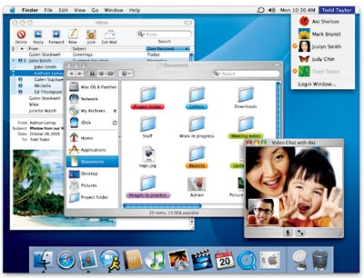
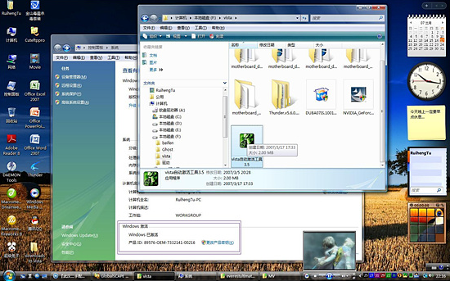

Slide 6
GUI still follows “Dr. IPO”
User controls contents, structure, and appearance of objects and their displayed images via rapid visual feedback
Basic components of an interactive graphics system
input (e.g., mouse, tablet and stylus, force feedback device, scanner…)
processing (and storage)
display/output (e.g., screen, paper-based printer, video recorder…)
PPTs from other\www.informatics.buu.ac.th_~kubola_975354Graphics\GraphicLect01_Introduction.ppt

Slide 7
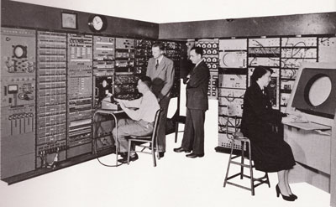
1950, Whirlwind Computer @ MIT
The first digital computer capable of displaying real time text and graphics on a video terminal
which at this time was a large oscilloscope screen
The Whirlwind was also the first computer to use Core Memory for RAM, a storage method that flourished until the 1970's.
Core memory permanently stores binary data on tiny donut shaped magnets strung together by a wire grid.

Slide 8
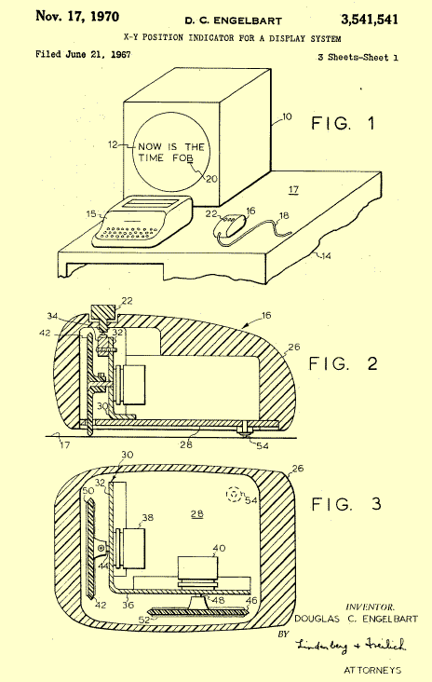
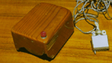
GUI History
In 1962, Douglas Engelbart invented the first “mouse,” which he called an “X-Y Position Indicator.”
It was a little gizmo housed in a wooden box on wheels that moved around the desktop and took the cursor with it on the display.
Source: US Patent Office
Notes:
Sketchpad pioneered the concepts of graphical computing, including memory structures to store objects, rubber-banding of lines, the ability to zoom in and out on the display, and the ability to make perfect lines, corners, and joints.

Slide 9
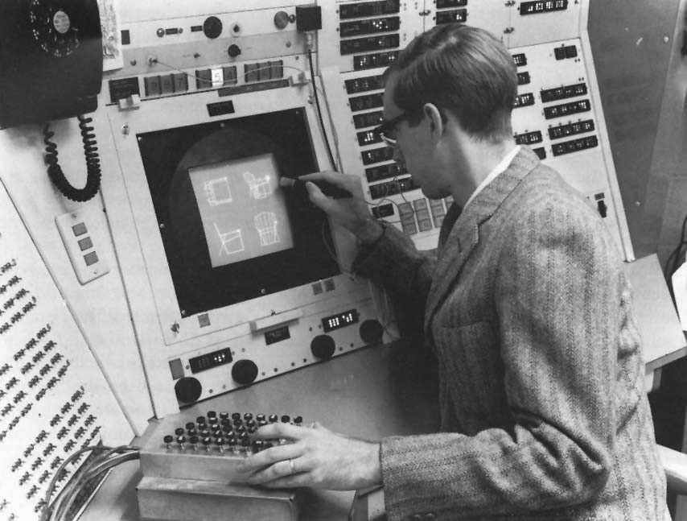
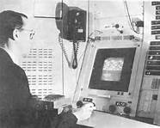
GUI History
In 1963 a grad student at MIT, Ivan Sutherland, submitted as his thesis a program called “Sketchpad.” This was the first GUI (Graphical User Interface) long before the term was coined."
http://accad.osu.edu/~waynec/history/images/ivan-sutherland.jpg

Slide 10
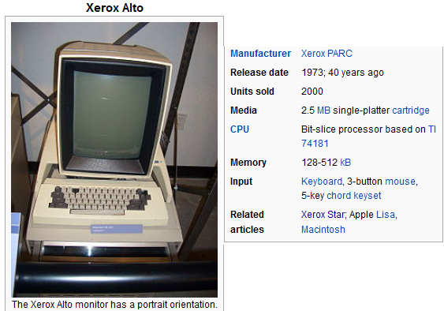
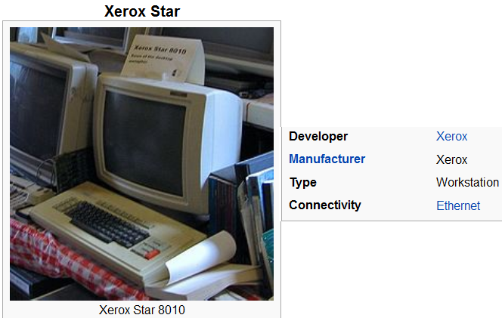
“Hall of Fame”
http://en.wikipedia.org/wiki/Xerox_Alto
http://en.wikipedia.org/wiki/Xerox_Star
In the 1970's, Xerox Labs developed Alto and STAR and introduced mouse pointing and selecting.
Xerox never successfully marketed their advances.
Apple and its Macintosh computer introduced the graphical user interface to the mass market.

Slide 11
The Xerox Alto was one of the first computers designed for individual use (though not as a home computer), making it arguably what is now called a personal computer. It was developed at Xerox PARC in 1973. It was the first computer to use the desktop metaphor and mouse-driven graphical user interface (GUI).
http://en.wikipedia.org/wiki/Xerox_Alto

Slide 12
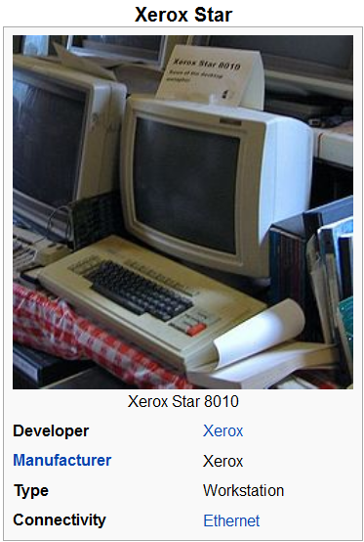
http://en.wikipedia.org/wiki/Xerox_Star
The Star workstation, officially known as the Xerox 8010 Information System, was introduced by Xerox Corporation in 1981. It was the first commercial system to incorporate various technologies that today have become commonplace in personal computers, including a bitmapped display, a window-based graphical user interface, icons, folders, mouse (two-button), Ethernet networking, file servers, print servers and e-mail.

Slide 13
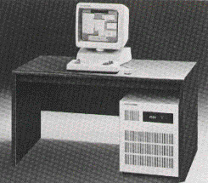
GUI History
In the 1970s, at Xerox’s PARC facility, Alan Keys created an object-oriented graphical programming language called “Smalltalk.” Smalltalk featured a graphical user interface (GUI) that looked suspiciously similar to later iterations from both Apple and Microsoft.
http://www.sra.co.jp/people/aoki/SqueakIdioms/chapter01/Xerox1100SIP.jpg
Notes:
First system based upon usability engineering
inspired design
extensive paper prototyping and usage analysis
usability testing with potential users
iterative refinement of interface

Slide 14
GUI History
1981, Xerox attempted to market the “Star.” It introduced the idea of what you see is what you get (WYSIWYG).
Commercial failure
cost ($15,000);
IBM had just announced a less expensive machine
limited functionality
e.g., no spreadsheet
closed architecture,
3rd party vendors could not add applications
perceived as slow
but really fast!
slavish adherence to direct manipulation
http://www.catb.org/~esr/writings/taouu/html/graphics/xerox_star.jpg

Slide 15
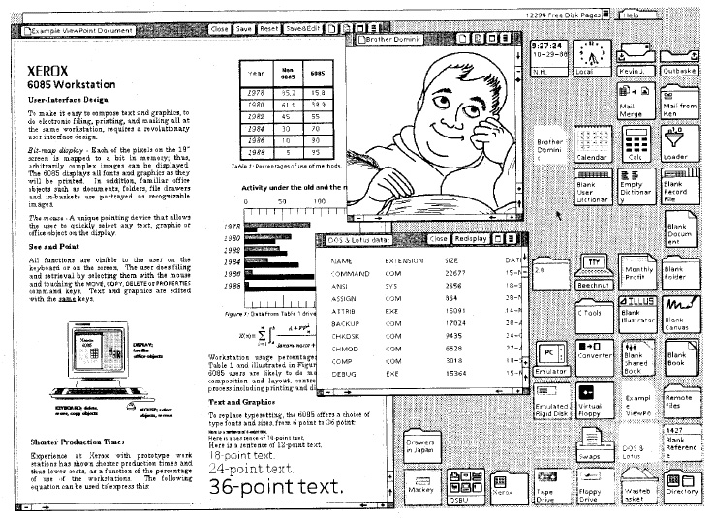
Screenshot of Xerox’s Star

Slide 16
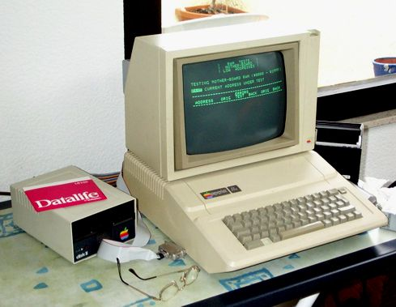
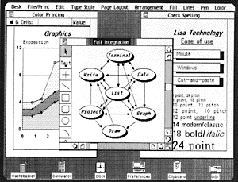
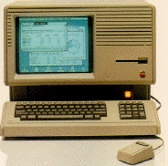
Apple gets a GUI
In 1983, the Apple Lisa was first GUI offering.
Apple II, 1980
http://www.s-line.de/homepages/horber-privat/bilder/apple2a.jpg
Lisa
http://fp3.antelecom.net/gcifu/applemuseum/lisa2.html

Slide 17
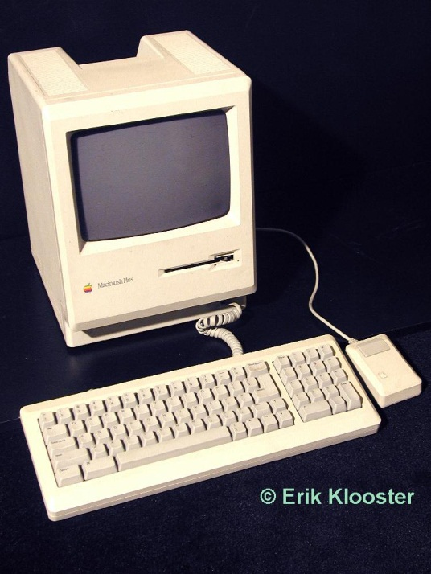
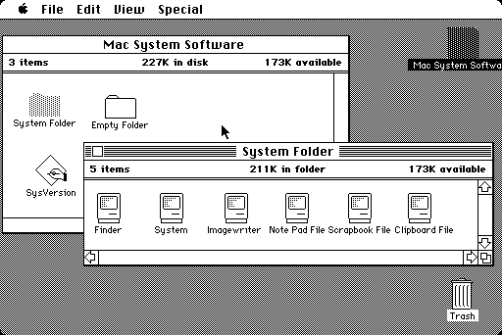
Apple gets a GUI
http://computermuseum.50megs.com/images/collection/apple-mac-plus.jpg
In 1984, Macintosh was the first computer with a GUI marketed to the masses.
“old ideas” but well done!
Commercial success because:
aggressive pricing ($2500)
did not need to trail blaze
learned from mistakes of Lisa and corrected them; ideas now “mature”
market now ready for them
developer’s toolkit encouraged 3rd party non-Apple software
interface guidelines encouraged consistency between applications
domination in desktop publishing because of affordable laser printer and excellent graphics
Full Microsoft Office suite (Apple was the dominant player at this time.)
http://toastytech.com/guis/bigmac1.gif

Slide 18
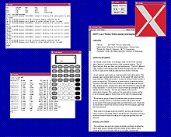
Unix Gets a GUI
The X Windows System was introduced in the mid-1980s to provide graphical support for unix operating systems.
The implementation was a client-server approach, where an X window system server ran on the displaying machine, and the client programs communicated with it using a network protocol.
X provides only a communication mechanism, not policy. At least three major user interface look & feel styles are widely used on X - MIT's own Athena style, Sun and AT&T's OpenLook, and OSF's Motif (supported primarily by HP and IBM).
http://www.pattosoft.com.au/jason/Articles/HistoryOfComputers/X11.gif

Slide 19
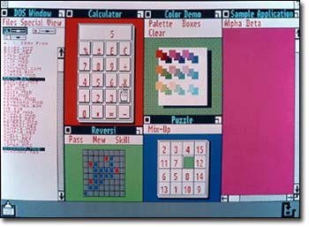
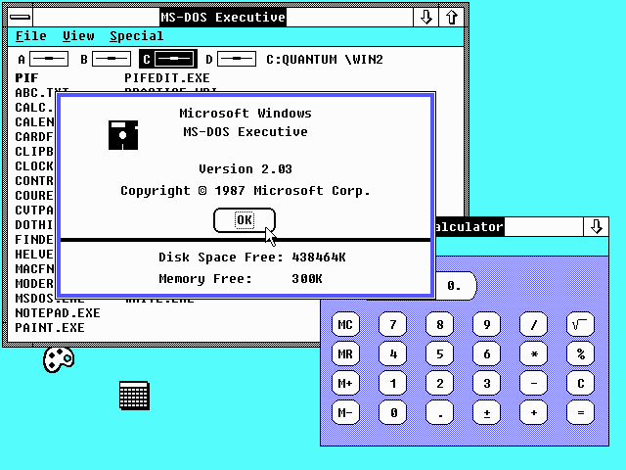
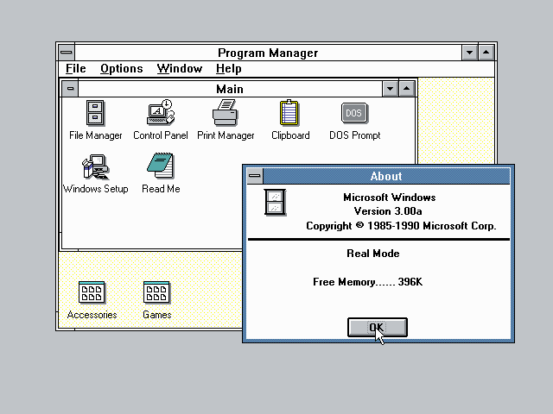
Microsoft Gets a GUI
Microsoft introduced Windows 1.0 in 1985
Tiled Windows, no overlapping
Windows 2.03 in 1987
Overlapping windows
Windows 3.0 in 1990
Features Program Manager

Slide 20
Shells
Unix and DOS operating systems circa 1980s do support text-based user interfaces via a program called a shell. These shells insert another layer between the user and the operating system. Typical text shells under unix are csh and ksh. The typical text shell under microsoft is command.com. It is still emulated today by cmd.exe.
Original unix and Microsoft GUI support was also implemented as shells. The dominant unix GUI library became an open library called X11 supported by the X.org foundation. Microsoft introduced Windows 1.0 as a shell that ran on a layer above MS-DOS.
The original Apple GUI is embedded into its operating system kernel. Windows migrated to embedding GUI support beginning with Windows NT.
Notes:
The Microsoft shell command.com is delivered as part of its MS-DOS operating system. IBM’s proprietary clone PC-DOS, and its original competitor DR-DOS.

Slide 21
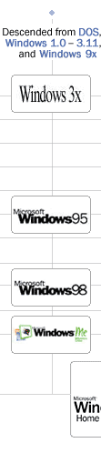
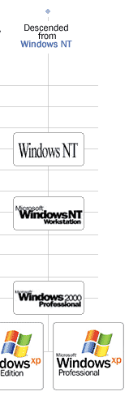
Windows Timeline
It took roughly 15 years to consolidate its shell-based GUI architecture offerings with its embedded GUI architecture offerings.
http://www.microsoft.com/windows/WinHistoryProGraphic.mspx

Slide 22
Now: Graphics for the masses!
What enabled the sudden shift?
Chief hardware advances:
Cheap RAM
graphics buffers are memory hogs
Success of raster graphics (vs. vector)
display (CRT) could be like cheap TV
Fast, cheap CPUs
calculations for drawing & rendering fonts
All thanks to integrated circuit technology!

Slide 23
GOO-ee
GUI and its history
Mechanism of GUI devices
Composing figures in VC’s Memory, and Painting dots on Raster display
Support from OS
Complements

Slide 24
Computer graphic system
5 major elements
Processor/CPU
Memory
Frame buffer
Input devices
Output Devices
Res-GUI\02_GraphicDevices.ppt
http://www.informatics.buu.ac.th/~kubola/310355/Lectures/02_GraphicDevices.ppt

Slide 25
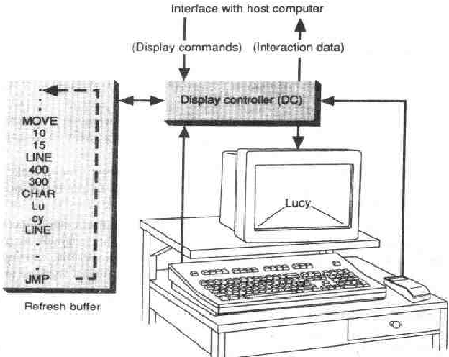
Mechanism of GUI devices
A typical vector system consists of a display processor (connected as an IO peripheral to CPU), a display buffer memory, and a CRT
1966 ~ 1980
Vector display
The display devices developed in mid-sixties and in common use until the mid-eighties are called vector, stroke, line drawing or calligrpahic display.
Term vector is used as a synonym for line here; a stroke is a short line, and characters are made of sequences of such strokes
The buffer stores the computer-produced display list or display program; it contains point- and line-plotting commands with (x, y) or (x, y, z) endpoint coordinates, as well as character-plotting commands

Slide 26
Calligraphic Displays
also called vector, stroke or line drawing graphics
lines drawn directly on phosphor
display processor directs electron beam according to list of lines defined in a "display list“
phosphors glow for only a few micro-seconds so lines must be redrawn or refreshed constantly
deflection speed limits # of lines that can be drawn without flicker.
Res-GUI\02_GraphicDevices.ppt
http://www.informatics.buu.ac.th/~kubola/310355/Lectures/02_GraphicDevices.ppt

Slide 27
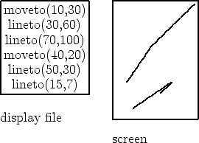
Res-GUI\02_GraphicDevices.ppt
Images are described in terms of line segments rather than pixels.
Display processor cycles through the commands
http://www.informatics.buu.ac.th/~kubola/310355/Lectures/02_GraphicDevices.ppt

Slide 28
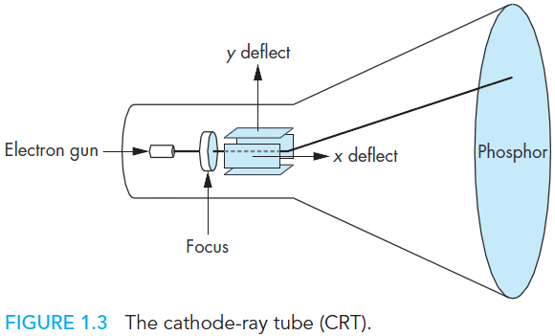
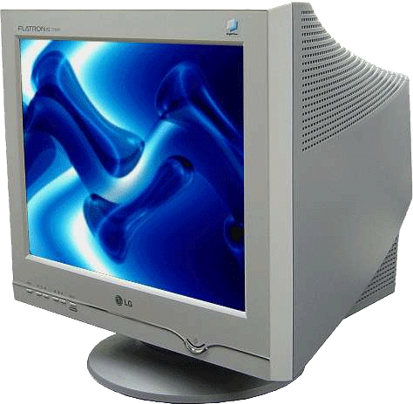
Also 1960s - DVST
Direct View Storage Tube 直观存贮显象管
The commands for plotting points, lines, and characters are interpreted by the display processor.
It sends digital and point coordinates to a vector generator that converts the digital coordinate values to analog voltages for beam-deflection circuits that displace an electron beam writing on CRT's phosphor coating

Slide 29
Raster Display [栅格显示器]
Display primitives (lines, shaded regions, characters) stored as pixels in refresh buffer (or frame buffer)
Electron beam scans a regular pattern of horizontal raster lines connected by horizontal retraces and vertical retrace
Video controller coordinates the repeated scanning
Pixels are individual dots on a raster line
http://www.informatics.buu.ac.th/~kubola/310355/Lectures/02_GraphicDevices.ppt

Slide 30
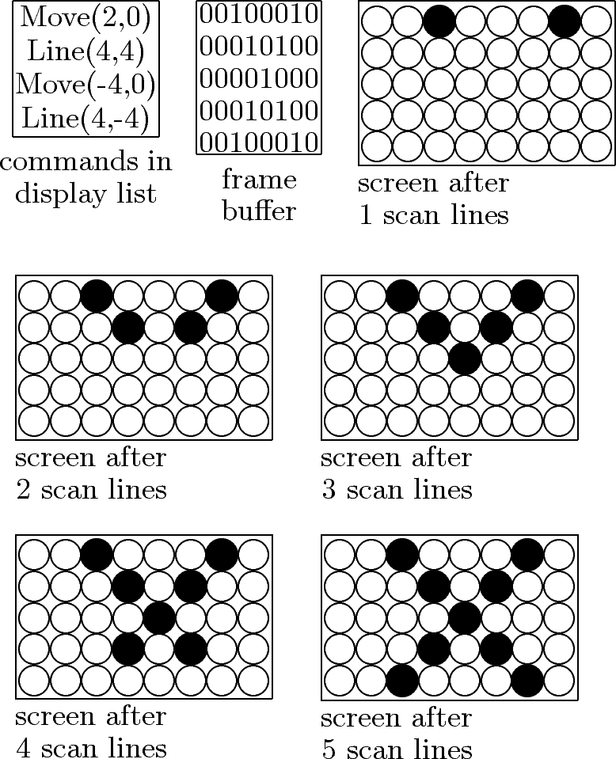
http://www.informatics.buu.ac.th/~kubola/310355/Lectures/02_GraphicDevices.ppt

Slide 31
Basic Definitions
Raster: A rectangular array of points or dots.
Pixel (Pel): One dot or picture element of the raster
Scan line: A row of pixels
Video raster devices display an image by sequentially drawing out the pixels of the scan lines that form the raster.
http://www.informatics.buu.ac.th/~kubola/310355/Lectures/02_GraphicDevices.ppt

Slide 32
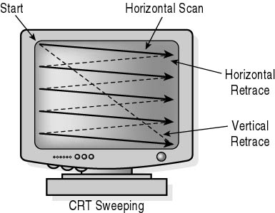
Refresh Rates and Bandwidth
Frames per second (FPS)
TV (interlaced) 30 FPS x 1/4 = 8 MB/s
http://www.informatics.buu.ac.th/~kubola/310355/Lectures/02_GraphicDevices.ppt

Slide 33
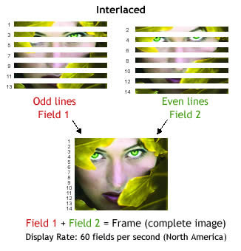
http://www.informatics.buu.ac.th/~kubola/310355/Lectures/02_GraphicDevices.ppt

Slide 34
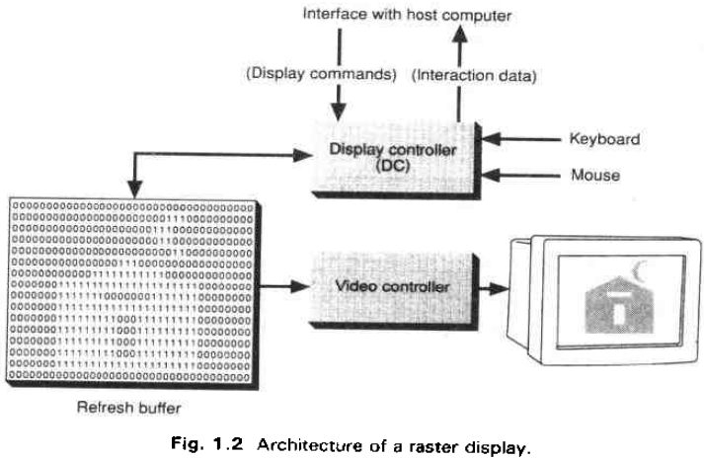
Then, new architecture for GUI

Slide 35
Frame Buffer
A frame buffer is characterized by size, x, y, and pixel depth.
the resolution of a frame buffer is the number of pixels in the display. e.g. 1024x1024 pixels.
Bit Planes or Bit Depth is the number of bits corresponding to each pixel. This determines the color resolution of the buffer.
Bilevel or monochrome displays have 1 bit/pixel
8bits/pixel -> 256 simultaneous colors
24bits/pixel -> 16 million simultaneous colors
http://www.informatics.buu.ac.th/~kubola/310355/Lectures/02_GraphicDevices.ppt

Slide 36
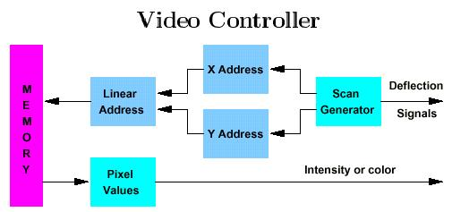
Video Controller
Problems with memory access { 50 ns pixel time (480 x 640 x 60 Hz) is shorter than typical 200 ns RAM cycle time.
- Must fetch multiple pixels per access.
- Can eat up a lot of memory bandwidth.
- Can eat up a lot of main bus bandwidth if so organized.
http://www.informatics.buu.ac.th/~kubola/310355/Lectures/02_GraphicDevices.ppt

Slide 37
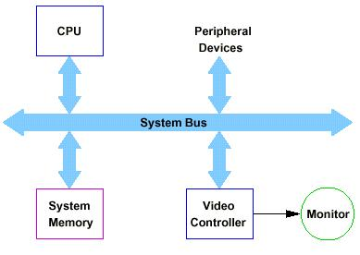
Simple Raster systems
http://www.informatics.buu.ac.th/~kubola/310355/Lectures/02_GraphicDevices.ppt
No special graphics processing except video controller. Two basic frame-buffer mappings.
Single ported frame buffer
Passes video information over system bus.
Simple and flexible.
Problems with bus congestion.

Slide 38
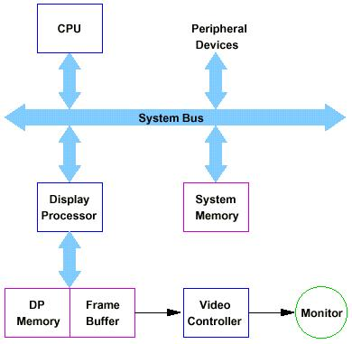
Graphics processor has its local memory and manages the frame buffer and specialized graphics programs.
Typical architecture for "plug in" graphics cards.
http://www.informatics.buu.ac.th/~kubola/310355/Lectures/02_GraphicDevices.ppt

Slide 39
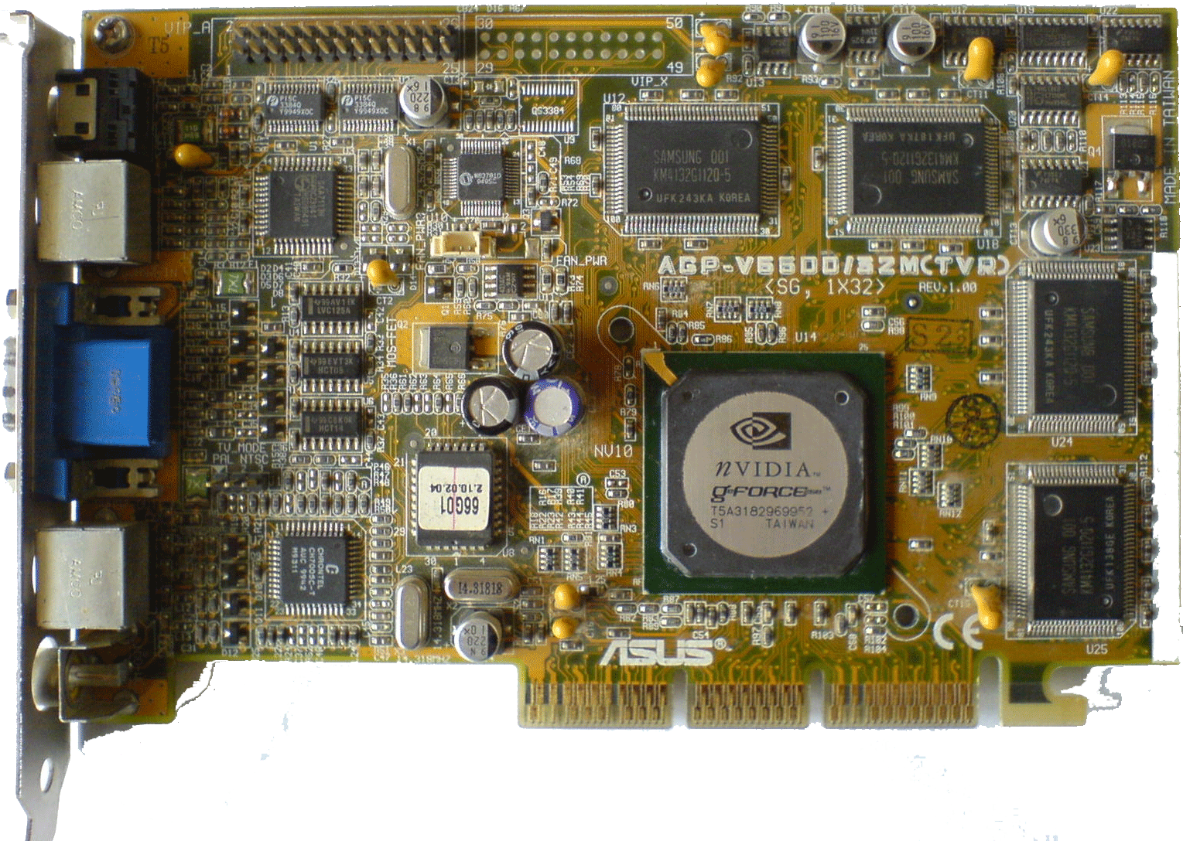
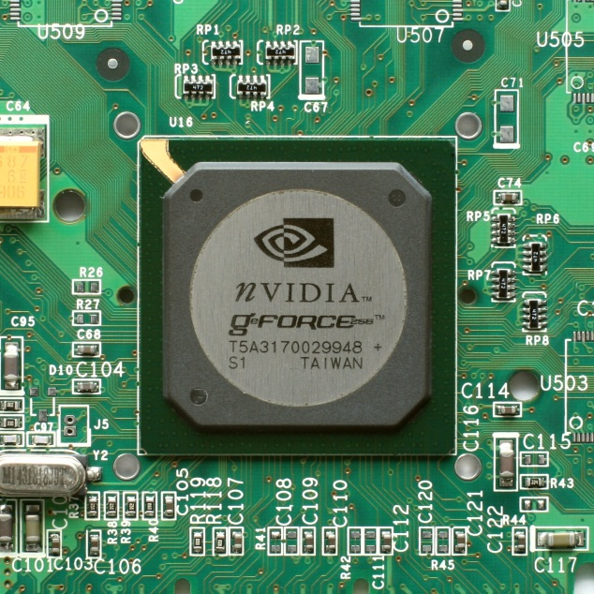
Example: GeForce 256
http://www.informatics.buu.ac.th/~kubola/310355/Lectures/02_GraphicDevices.ppt
Released in 1999.
One chip solution; 2D and 3D support. 2D includes MPEG-2 (DVD) decoder.
RAM from 32MB-128MB
GeForce GPU (graphics processing unit) has 23 million transistors ... more than Intel PIII.

Slide 40
GOO-ee
GUI and its history
Mechanism of GUI devices
Support from OS
Based on Device management
A special course named “Computer Graphics”
Interactions are based on event driven programs
Complements

Slide 41
Logic of GUI
With the VC (of course its drivers), GUI could be seen as a region you can draw pictures
It first defines a Desktop area – the display region, but with coordinate different from Cartesian coordinate
Figures are put into VC’s memory, the controller then show them in the display – CRT, LED, …
(0,0)
(1280,800)

Slide 42
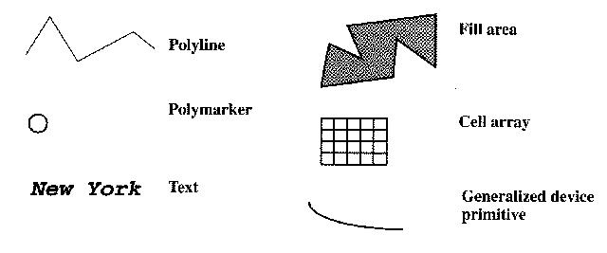
Logic of GUI
http://en.wikipedia.org/wiki/PHIGS
Beyond VC, there is another layer to provide Graphic Output Primitives (line, arc, region, …) defined in some standard GSS (Graphic Support Software)
There are many standards – GKS, PHIGS, CGI
Graphics Kernel System 计算机图形核心系统
Programmer's Hierarchical Interactive Graphics System,程序员层次交互图形系统
Computer Graphics Interface 计算机图形接口
(0,0)
(1280,800)
http://www.geog.ucsb.edu/~kclarke/G128/Lecture12.html

Slide 43
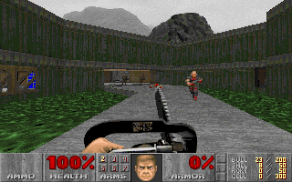
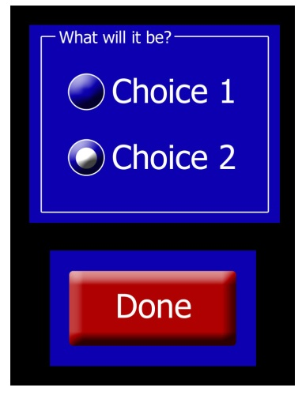
Logic of GUI
http://en.wikipedia.org/wiki/PHIGS
Beyond VC, there is another layer to provide Graphic Output Primitives (line, arc, region, …) defined in some standard GSS (Graphic Support Software)
There are many standards – GKS, PHIGS, CGI
Graphics Kernel System 计算机图形核心系统
Programmer's Hierarchical Interactive Graphics System,程序员层次交互图形系统
Computer Graphics Interface 计算机图形接口
(0,0)
(1280,800)
http://www.geog.ucsb.edu/~kclarke/G128/Lecture12.html

Slide 44
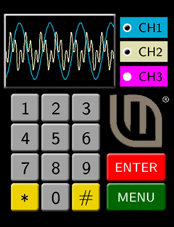
Logic of GUI
http://en.wikipedia.org/wiki/PHIGS
Beyond VC, there is another layer to provide Graphic Output Primitives (line, arc, region, …) defined in some standard GSS (Graphic Support Software)
There are many standards – GKS, PHIGS, CGI
Graphics Kernel System 计算机图形核心系统
Programmer's Hierarchical Interactive Graphics System,程序员层次交互图形系统
Computer Graphics Interface 计算机图形接口
(0,0)
(1280,800)
http://www.geog.ucsb.edu/~kclarke/G128/Lecture12.html

Slide 45
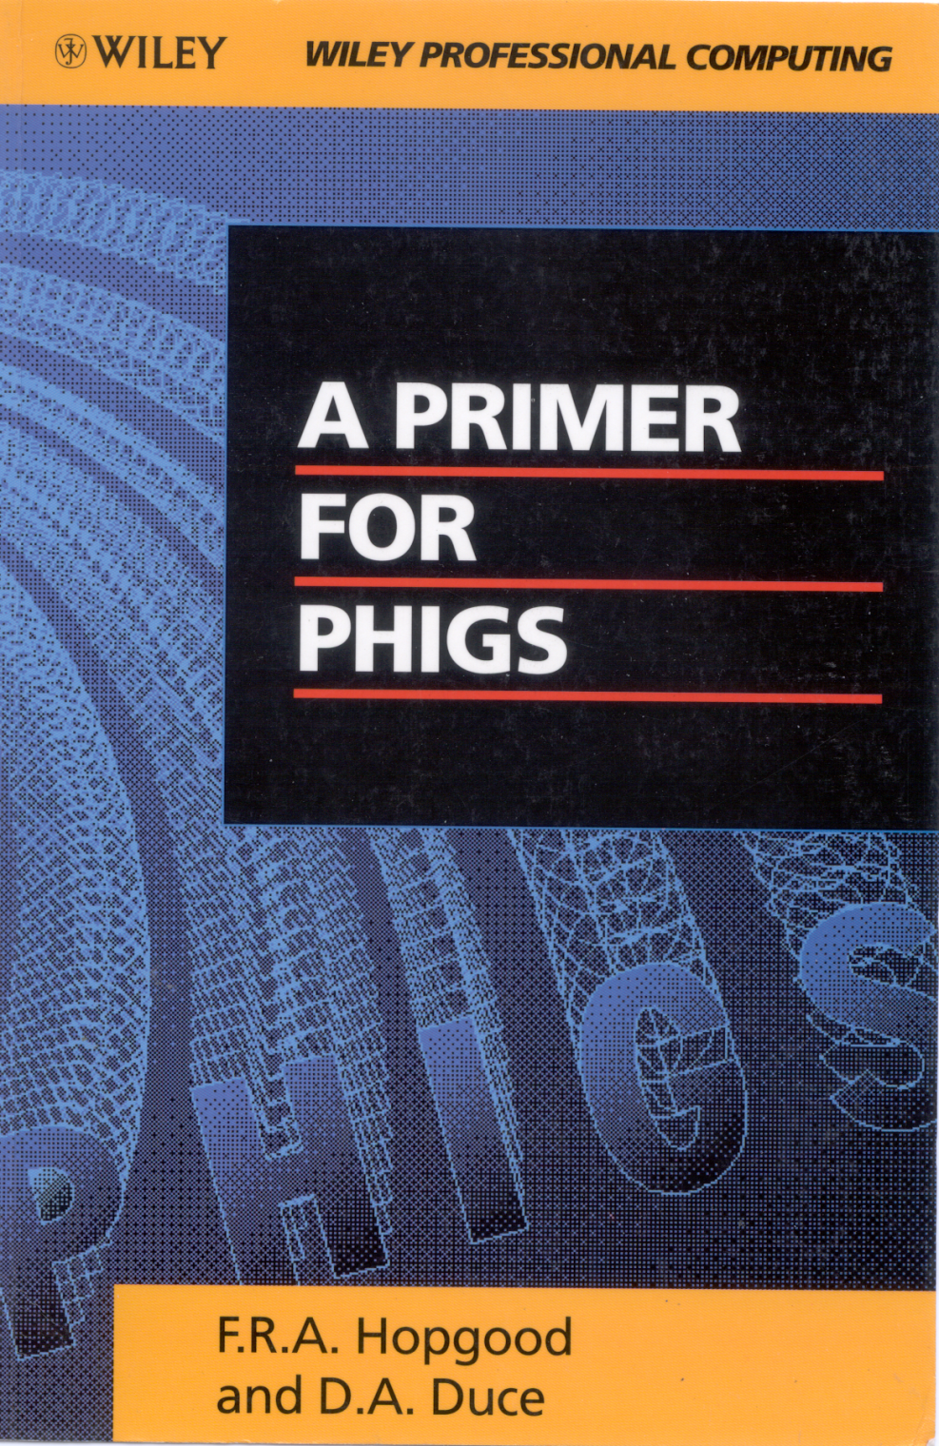
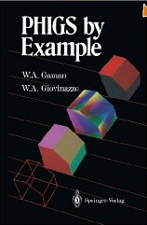
http://www.chilton-computing.org.uk/acd/literature/books/phigs/contents.htm

Slide 46
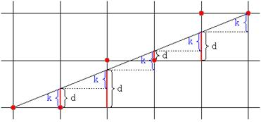
A special course named Computer Graphics (CG), which aims to consider how to represent figures
How to draw lines by using dots?
V
How to represent 2-/3-D by transformations?
N₃
P₀
N₁
N₂

Slide 47
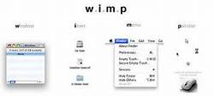
Logic of GUI
Similar with the relationship between basic data type (int, char) and compound data type (struct, union), it’s convenient to provide higher abstraction based on primitives, that is the GUI components – WIMP
Called Graphic Application Software, like OpenGL, DirectX
(0,0)
(1280,800)

Slide 48
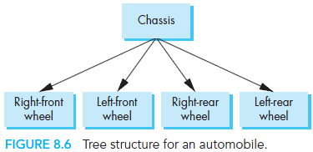
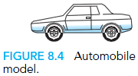
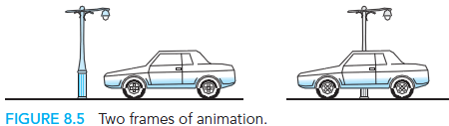

The most important type of graph we use is a tree. A (connected) tree is a directed graph without closed paths or loops.

Slide 49


Logic of GUI
With Interrupt, OS can capture the position of your mouse as well as the input from keyboard, and then send messages to combine position with functions connected with GUI components
This is called event driven mechanism
(0,0)
Mouse movement captured and mapped during a whole day
http://aggronaut.com/2009/05/07/keyboard-turning-is-killing-your-raid/
(1280,800)
http://www.artlayer.com/mouse-movement-screen-mapping

Slide 50


Slide 51

计算机图形学原理及实践：C语言描述（原书第2版）.pdf

Slide 52


Slide 53


Slide 54

计算机图形学原理及实践：C语言描述（原书第2版）.pdf

Slide 55

计算机图形学原理及实践：C语言描述（原书第2版）.pdf

Slide 56


Application programmer’s model of graphics system
http://www.pearsonhighered.com/educator/academic/product/0,3110,0321535863,00.html

Slide 57


Logic of GUI v.s File system
GUI applications
Organize GUI components – WIMP, and compute the representations with primitive figures, OpenGL, DirectX
Processes
Graphic Application Software
File System Calls
File System
map files to disk blocks …
Provide basic figures like lines, region, etc.
Several standards: GKS,PHIGS,CGI
Graphic Support Software
map disk block number
to physical
disk address (cyl#,track#, sector#, etc)
Disk Driver
Map the figures in VC’s memory as pixels/dots to display
Video card Driver
Disk Controller
Video card
cylinders,
tracks,
sectors
Disk
Notes:
The History of OpenGL
The Open Graphics Library (OpenGL) is a standard specification defining a cross-language, cross-platform Application Program(ming) Interface (API). OpenGL provides the programmer an interface to the graphics hardware. OpenGL is a powerful, low-level rendering and modeling software library.
With OpenGL it is possible to produce 2D and 3D graphics applications. OpenGL is widely used in video games, CAD, scientific applications, etc, on many different platforms.
Many commercial games, such as the ID Software's Quake series, use OpenGL for their graphics engines.
History
In the 1980's developing software was a challenge. Especially when you wanted to program for a wide range of graphics hardware. (Remember, at that time there were no API's that could be used).
The software developers had to write custom drivers for each piece of hardware. They also had to deal with a lot of different interfaces, which made the task even harder. (The development cycle was slow because of it). Another problem was that each development team (from different companies) had to write drivers for the same piece of hardware. The result was that there was a lot of the same source code been written by different teams. (Waste of time and money).
In the early 90's Silicon Graphics inc. was a leader in 3D graphics for workstations. They used an API called IRIS GL for their workstations. IRIS GL was proprietary to SGI's hardware and not an "open" standard. The API was considered to easy to use and it also supported immediate mode rendering.
At that time competing vendors, including Sun Microsystems, IBM and Hewlett-Packard were also bringing 3D hardware on the market. They used another API called PHIGS. (In funcionality and capability IRIS GL was superior to PHIGS).
Because other vendors brought new 3D hardware on the market, SGI's market share became smaller.
To turn the tide and influence the market SGI decided to turn the IRIS GL into an open standard. (They could not make IRIS GL an open standard because of licensing and patent issues). They made a new API based on IRIS GL called OpenGL.
In 1992, SGI led the creation of the OpenGL architectural review board (ARB). (The founding companies of the ARB were: SGI, Microsoft, IBM, DEC and Intel. Today nine companies have voting seats on the ARB, and several more attend the quarterly meetings to provide input to the evolution of OpenGL). The role of the OpenGL ARB is to establish and maintain the OpenGL specifications.
Not all advanced hardware-specific features can be accessed by the OpenGL versions (default Opengl). (Remember, a new version of OpenGL is not released very often). Fortunately, the video-card manufactures can and do provide OpenGL extensions. With these extensions you are able to access advanced hardware-specific features.
If these features are used by many vendors, the extensions can become an official addition to the OpenGL standard. (In an old version (OpenGL 1.2) an advanced feature (add that time) was requested by game developers called multi-texturing).
Future releases of OpenGL will be more and more influenced by game developers and the gaming industry.
--- http://www.codingunit.com/the-history-of-opengl

Slide 58

Notes:
UIMS: User Interface Management System

Slide 59

计算机图形学原理及实践：C语言描述（原书第2版）.pdf

Slide 60

计算机图形学原理及实践：C语言描述（原书第2版）.pdf

Slide 61


Game Engines
There are many game engines which are proposed by game producers for special game figures and components
http://khmergame.com/torque_game.html
http://forum.thegamecreators.com/?m=forum_view&t=165850&b=19

Slide 62
GOO-ee
GUI and its history
Mechanism of GUI devices
Support from OS
Complements
Colorful GUI
3D Input/Output
Virtual Reality
Do you remember Avatar?

Slide 63
Specifying Color
direct color :
each pixel directly specifies a color value
e.g., 24bit : 8bits(R) + 8bits(G) + 8 bits(B)
palette-based color : indirect specification
use palette (CLUT)
e.g., 8 bits pixel can represent 256 colors
8
8
8
Red
Green
Blue
24 bits plane, 8 bits per color gun.
2²⁴ = 16,777,216
http://www.informatics.buu.ac.th/~kubola/310355/Lectures/02_GraphicDevices.ppt

Slide 64

Color CRTs
Color CRTs have
Three electron guns
A metal shadow mask to differentiate the beams
http://www.udayton.edu/~cps/cps460/notes/displays/
http://www.informatics.buu.ac.th/~kubola/310355/Lectures/02_GraphicDevices.ppt

Slide 65

LCDs
Liquid Crystal Displays (LCDs)
LCDs: organic molecules, naturally in crystalline state, that liquefy when excited by heat or E field
Crystalline state twists polarized light 90º.
http://www.udayton.edu/~cps/cps460/notes/displays/
http://www.informatics.buu.ac.th/~kubola/310355/Lectures/02_GraphicDevices.ppt

Slide 66

Transmissive & reflective LCDs:
LCDs act as light valves, not light emitters, and thus rely on an external light source.
Laptop screen: backlit, transmissive display
Palm Pilot/Game Boy: reflective display
http://www.udayton.edu/~cps/cps460/notes/displays/
http://www.informatics.buu.ac.th/~kubola/310355/Lectures/02_GraphicDevices.ppt

Slide 67


Plasma [等离子]
Plasma display panels
Similar in principle to fluorescent light tubes
Small gas-filled capsules are excited by electric field, emits UV light
UV excites phosphor
Phosphor relaxes, emits some other color
http://www.informatics.buu.ac.th/~kubola/310355/Lectures/02_GraphicDevices.ppt

Slide 68
Plasma Display Panel Pros and Cons
Plasma Display Panel Pros
Large viewing angle
Good for large-format displays
Fairly bright
Cons
Still very expensive
Large pixels (~1 mm versus ~0.2 mm)
Phosphors gradually deplete
Less bright than CRTs, using more power
http://www.informatics.buu.ac.th/~kubola/310355/Lectures/02_GraphicDevices.ppt

Slide 69


DMDs [数字微镜器件]
Digital Micromirror Devices (projectors)
Microelectromechanical (MEM) devices, fabricated with VLSI techniques
http://www.informatics.buu.ac.th/~kubola/310355/Lectures/02_GraphicDevices.ppt

Slide 70


DMDs Pros and Cons
http://en.wikipedia.org/wiki/Digital_micromirror_device
DMDs are truly digital pixels
Vary grey levels by modulating pulse length
Color: multiple chips, or color-wheel
Great resolution
Very bright
Flicker problems
http://www.informatics.buu.ac.th/~kubola/310355/Lectures/02_GraphicDevices.ppt

Slide 71


FEDs [场致发射器件]
Field Emission Devices (FEDs)
Like a CRT, with many small electron guns at each pixel
Unreliable electrodes, needs vacuum
Thin, but limited in size
http://www.informatics.buu.ac.th/~kubola/310355/Lectures/02_GraphicDevices.ppt

Slide 72


Organic LED [全球有机发光二极管] Arrays
Organic Light-Emitting Diode (OLED) Arrays
The display of the future? Many think so.
OLEDs function like regular semiconductor LEDs
But with thin-film polymer construction:
Thin-film deposition or vacuum deposition process…not grown like a crystal, no high-temperature doping
Thus, easier to create large-area OLEDs
http://www.informatics.buu.ac.th/~kubola/310355/Lectures/02_GraphicDevices.ppt

Slide 73



Render farms
Closely related to Beowulf clusters
Idea: Use many tightly-coupled off-the-shelf machines to do rendering
Problem: Dividing the work
But sometimes easy, e.g. one frame per machine
Example: Titanic water effects used cluster of about 160 Alphas running Linux/NT.
http://www.informatics.buu.ac.th/~kubola/310355/Lectures/02_GraphicDevices.ppt

Slide 74


3D Input Device
Electromagnetic trackers
can be attached to any head, hands, joints, objects
Polhemus FASTRAK™(used in Brown’s Cave)
Acoustic-inertial trackers
Intersense IS-900
http://www.polhemus.com/ftrakds.htm
http://www.isense.com/products/prec/is900/index.htm
http://www.informatics.buu.ac.th/~kubola/310355/Lectures/02_GraphicDevices.ppt

Slide 75


3D Input Device
Gloves
attach electromagnetic tracker to the hand
Pinch gloves
contact between digits is a “pinch” gesture
in CAVE, extended Fakespace PINCH™ gloves with extra contacts
http://www.fakespacelabs.com/products/pinch.html
http://www.informatics.buu.ac.th/~kubola/310355/Lectures/02_GraphicDevices.ppt

Slide 76


Video Output Devices
Classification
Stereo
head-mounted displays
shutter glasses
Degree of immersion
conventional desktop screen
walkup VR, semi-immersive displays immersive virtual reality
http://robotics.aist-nara.ac.jp/equipments/E-equips/hmd.html
http://www.virtualresearch.com/index.html
http://www.informatics.buu.ac.th/~kubola/310355/Lectures/02_GraphicDevices.ppt

Slide 77

Video Output Devices
Example of Immersive
Display
Diffusion Tensor MRI Brain Visualization at Brown University
http://www.cs.brown.edu/research/graphics/research/sciviz/brain/brain.html
http://www.informatics.buu.ac.th/~kubola/310355/Lectures/02_GraphicDevices.ppt

Slide 78



Video Output Devices
Immersive
Head-mounted displays (HMD)
Stereo shutter glasses
Virtual Retinal Display (VRD)
CAVE™
http://www.evl.uic.edu/research/template_res_project.php3?indi=27
http://www.informatics.buu.ac.th/~kubola/310355/Lectures/02_GraphicDevices.ppt

Slide 79



Slide 80


Do you remember Avatar?
http://james-camerons-avatar.wikia.com/wiki/The_Making_of_Avatar_%28book%29

